Slide 1

HIGH CLOUD AIRLINE ANALYSIS
By Group 4

Slide 2
Presented by Group 4 Members
Chaitra Sharnarthi
Malathi N
Ankitha Pandey
Sadiya Abdul Khadar
Athul M R
Nikhil Reddy

Slide 3
Content
Introduction
Business Overview
Project Scope
Data Model
Challenges Encountered
Dashboard Overview
Conclusion

Slide 4
Introduction
This project delivers a complete analytical study of High Cloud Airline’s operational performance using Excel, Tableau, Power BI, and MySQL.
The analysis covers more than 110,851 flight records, detailing passenger movement, aircraft utilization, route behaviour, and carrier-level operations.
The objective is to transform raw operational data into actionable insights through structured data cleaning, modelling, visualization, and metric-driven reporting.

Slide 5
Business Overview
High Cloud Airlines operates across a large and diverse network supported by:
206 unique carriers
18,320 point-to-point routes
Multiple aircraft groups, configurations, and regions
The dataset captures essential operational indicators such as seat availability, passenger volume, departure performance, and load factor.
Understanding these metrics is critical for optimizing capacity, improving route planning, and enhancing operational efficiency.

Slide 6
Project Scope
This project focuses on five major components:
1. Data Preparation: Cleaning and standardizing raw data, handling null values, validating fields, and ensuring consistency across 80+ columns.
2. Data Modelling: Structuring relationships between carriers, aircraft, origins/destinations, and time dimensions, Derived KPIs include Load Factor, Transported Passengers, Departures, and Seat Capacity.
3. Dashboard Development: Building interactive KPI dashboards in Tableau and Power BI that highlight monthly performance, route trends, carrier analysis, and aircraft utilization.
4. SQL Exploration: Using MySQL to validate aggregated numbers and extract statistical summaries for cross-verification
5. Insight Generation: Deriving operational insights that support decision-making around capacity, scheduling, and resource allocation

Slide 7

Data Model
A central fact table of 110k+ flight records
Dimensions across Carrier, Airport, Aircraft Type, Region, Distance Group, and Date
Core measures:
Transported Passengers: 187,022,609
Available Seats: 243,534,311
Departures Performed: 2,799,356
Average Load Factor: 6.03% (calculated value in dataset)

Slide 8
Challenges Encountered
Inconsistent column names with special characters (%, #)
Missing or incomplete values in passenger and seat-related fields
Very low %Load Factor values due to incorrect raw formula (needed recalculation)
Large dataset size causing slower calculations
Complex time-based fields requiring transformation
Duplicate route names across multiple months/aircraft
Establishing correct relationships for dashboards due to many ID columns

Slide 9
Dashboard Overview
The dashboard provides a consolidated view of airline performance, displaying key metrics such as Available Seats (243.53M), Load Factor (76.8%), Total Flights (110.85K), and Transported Passengers (187.02M).
1
Trend visuals highlight Load Factor variations by Year, Quarter, and Month, helping identify seasonal peaks and operational fluctuations.
2
Route-level insights reveal the Top 10 most travelled flight paths, with major connections like Washington → New York and Atlanta → Houston showing higher trip frequency.
3
Carrier performance charts identify the Top 10 airlines by passenger volume, with significant contributions from carriers like Delta Air Lines, Southwest Airlines, and Continental Air Lines.
4
Distance-based visuals show that the majority of flights operate in the “Less Than 500 Miles” category, indicating heavy reliance on short-haul routes.
5
Additional filters for Month, Quarter, Carrier, Day Type (Weekend/Weekday), and Route allow dynamic exploration of operational patterns and granular performance analysis
6

Slide 10

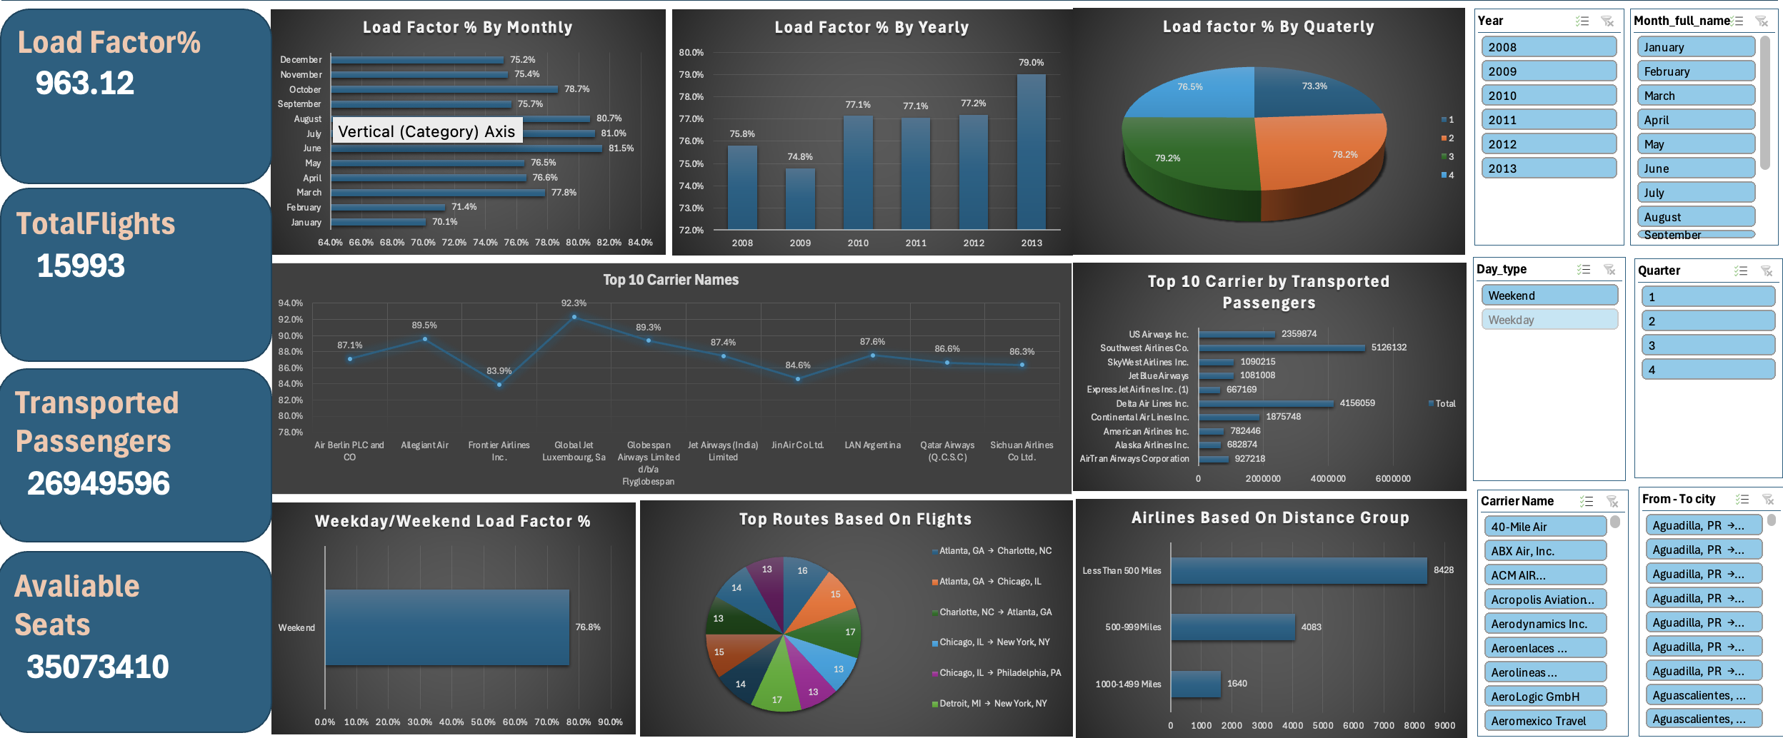
Excel Dashboard

Slide 11

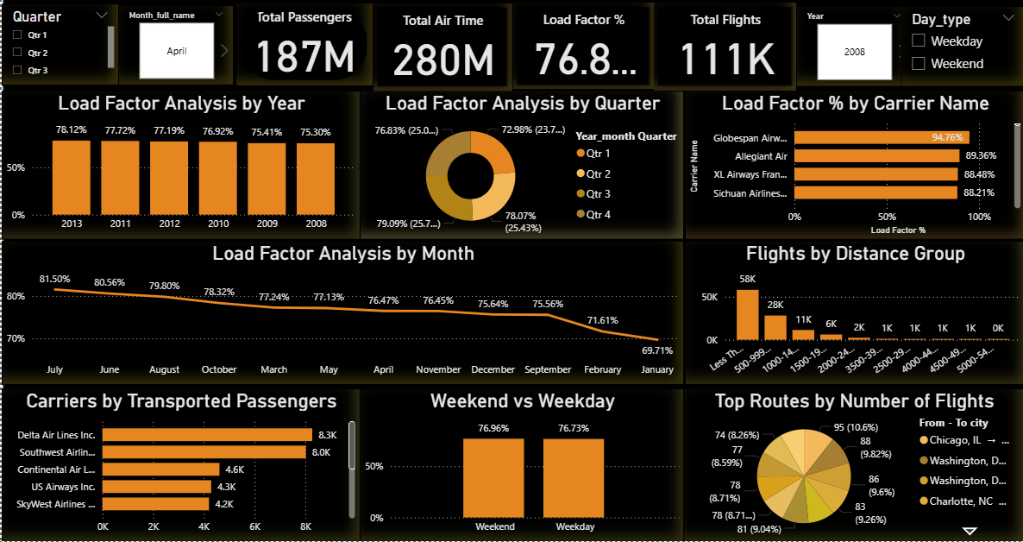
Power Bi Dashboard

Slide 12

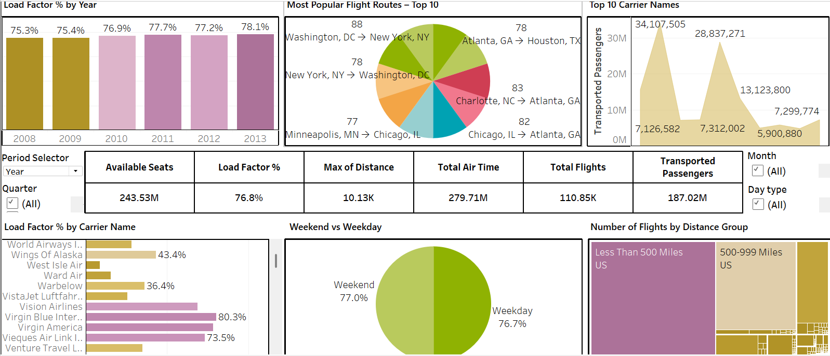
Tableau Dashboard

Slide 13
Conclusion
This project provides a complete analytics pipeline—from raw data to dashboard-driven insights—covering over 187 million passengers, 243 million seats, and 2.79 million departures.
Using Excel, Tableau, Power BI, and MySQL, the analysis delivers detailed visibility into airline operations and supports strategic decision-making in capacity planning, performance optimization, and route management.

Slide 14
Thankyou

